Slide 1
Chapter 10 Imaging Model and Camera Calibration
Prof. Lin ZHANG
School of Computer Science and Technology
Tongji University

Slide 2
Outline
What is Camera Calibration?
Modeling for Imaging Pipeline
General Framework for the Camera Calibration Algorithm
Initial Rough Estimation of Calibration Parameters
Nonlinear Least-squares
Image Un-distortion

Slide 3
What is camera calibration?
Camera calibration is a necessary step in 3D computer vision in order to extract metric information from 2D images
It estimates the parameters of a lens and image sensor of the camera; you can use these parameters to correct for lens distortion, measure the size of an object in world units, or determine the location of the camera in the scene
These tasks are used in applications such as machine vision to detect and measure objects. They are also used in robotics, for navigation systems, and 3-D scene reconstruction

Slide 4
What is camera calibration?

Slide 5
What is camera calibration?
Example: PnP (Perspective N Points) problem
Suppose a camera is calibrated (its intrinsics are known)
From a set of spatial points with known coordinates in the WCS and their pixel positions on the image, the pose of the camera with respect to the WCS can be recovered. This is a simple visual odometry.

Slide 6
What is camera calibration?
Camera parameters include
Intrinsics
Distortion coefficients
Extrinsics
To perform single camera calibration, you need to know:
How to model the imaging process?
What is the general workflow for camera calibration?
How to get the initial estimation of parameters?
How to solve a nonlinear optimization problem?

Slide 7
Outline
What is Camera Calibration?
Modeling for Imaging Pipeline
General Framework for the Camera Calibration Algorithm
Initial Rough Estimation of Calibration Parameters
Nonlinear Least-squares
Bird’s-eye-view Generation

Slide 8
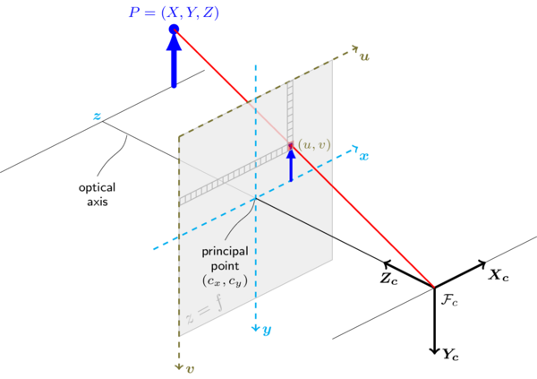
Modeling for Imaging Pipeline
For simplicity, usually we use a pinhole camera model
P=(X_{w}, Y_{w}, Z_{w})

Slide 9
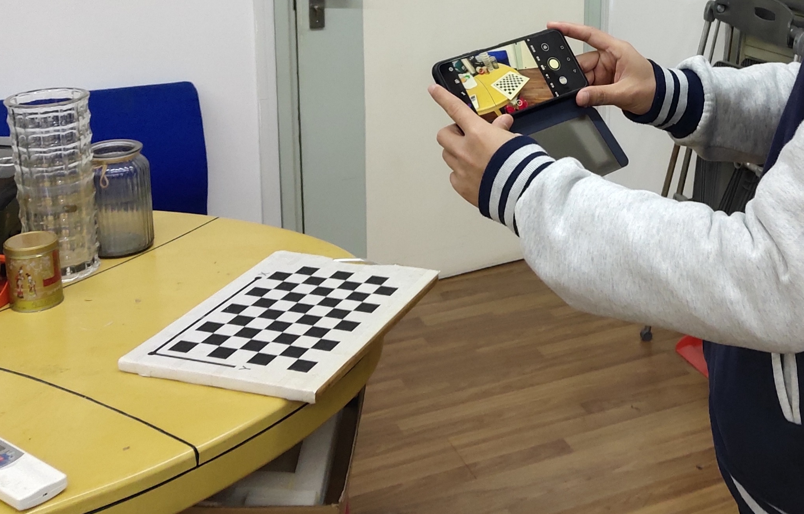
Modeling for Imaging Pipeline

Slide 10
Modeling for Imaging Pipeline
To model the image formation process, 4 coordinate systems are required
World coordinate system (3D space)
Camera coordinate system (3D space)
Retinal coordinate system (2D space)
Normalized retinal coordinate system (2D space)
Pixel coordinate system (2D space)

Slide 11
Modeling for Imaging Pipeline
From the world CS to the camera CS
is a 3D point represented in the WCS
In the camera CS, it is represented as,
(1)
a translation vector
a rotation matrix (orthogonal, det(R)=1)
(inhomogeneous)
(normalized homogeneous)

Slide 12
Modeling for Imaging Pipeline
From the camera CS to the retinal CS
We can use a pin-hole model to represent the mapping from the camera CS to the retinal CS
retinal
?
optical
center
where f is the distance between the retinal plane and the camera origin
The retinal plane is perpendicular to the optical axis.
Note: From the view of the camera CS, the coordinates of the point (x, y) on the retinal plane are (x,y,f)

Slide 13
Modeling for Imaging Pipeline
From the camera CS to the retinal CS
homogeneous form
(2)
normalized homogeneous
inhomogeneous

Slide 14
Modeling for Imaging Pipeline
*From the camera CS to the normalized retinal CS
Normalized retinal plane is a virtual plane with a distance 1 to the optical center
retinal
?
homogeneous form
optical
center
(3)
normalized homogeneous

Slide 15
Modeling for Imaging Pipeline
From the retinal CS to the pixel CS
The unit for retinal CS (x-y) is physical unit (e.g., mm, cm) while the unit for pixel CS (u-v) is pixel
Suppose that one pixel represents dx physical units along the x-axis and represents dy physical units along the y-axis, and the image of the optical center is (c_{x}, c_{y}) (pixels)
normalized homogeneous

Slide 16
Modeling for Imaging Pipeline
From the retinal CS to the pixel CS
If the two axis, u and v, of the image plane are not perpendicular,
(4)

Slide 17
Modeling for Imaging Pipeline
From Eqs.1, 2, and 4, we can have
Image formation model without considering lens distortions,
(5)
Note: u is the normalized homogeneous coordinates
intrinscis matrix
Extrinsics

Slide 18

Modeling for Imaging Pipeline
Some notes about the intrinsic matrix in practical use
In matlab, the skew parameter s is modeled
In openCV, for ordinary cameras, s is not modeled, meaning that it only considers four intrinsic parameters
In openCV, for fisheye cameras, s is modeled (after calibrating the fisheye cameras, you really can get five parameters); However, the related document has a mistake by saying that only four intrinsic parameters are considered
Note: In this course, we do not consider s anymore

Slide 19
Modeling for Imaging Pipeline
Point on the normalized retinal CS
(according to Eq.3)
Thus, we have a byproduct which states the relationship between the coordinates on the pixel CS and the coordinates on the normalized retinal CS,
Normalized homogeneous
(6)
Normalized homogeneous

Slide 20
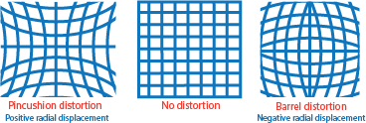
Modeling for Imaging Pipeline
To model the behavior of lens, we need to consider the distortion
Radial distortion occurs when light rays bend more near the edges of a lens than they do at its optical center; the smaller the lens, the greater the distortion

Slide 21
Modeling for Imaging Pipeline
To model the behavior of lens, we need to consider the distortion
Tangential distortion occurs when the lens and the image plane are not parallel

Slide 22
Modeling for Imaging Pipeline
To model the behavior of lens, we need to consider the distortion
Both the two types of distortions are modeled on the normalized retinal plane
To model radial distortion
To model tangential distortion
where
where
are the radial distortion coefficients
are the tangential distortion coefficients
If they both need to be considered,
Note: This step cannot be represented by matrix multiplication
(7)

Slide 23
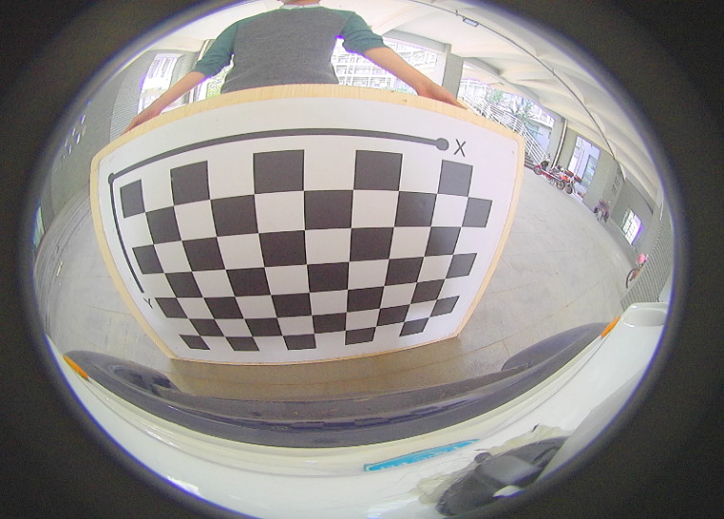
Modeling for Imaging Pipeline
To model the behavior of lens, we need to consider the distortion
Both the two types of distortions are modeled on the normalized retinal plane
If the FOV is extremely large (larger than 100 degrees), i.g. the camera is a fisheye camera, we need to use another model to characterize lens distortions
A typical image collected by a fisheye camera

Slide 24
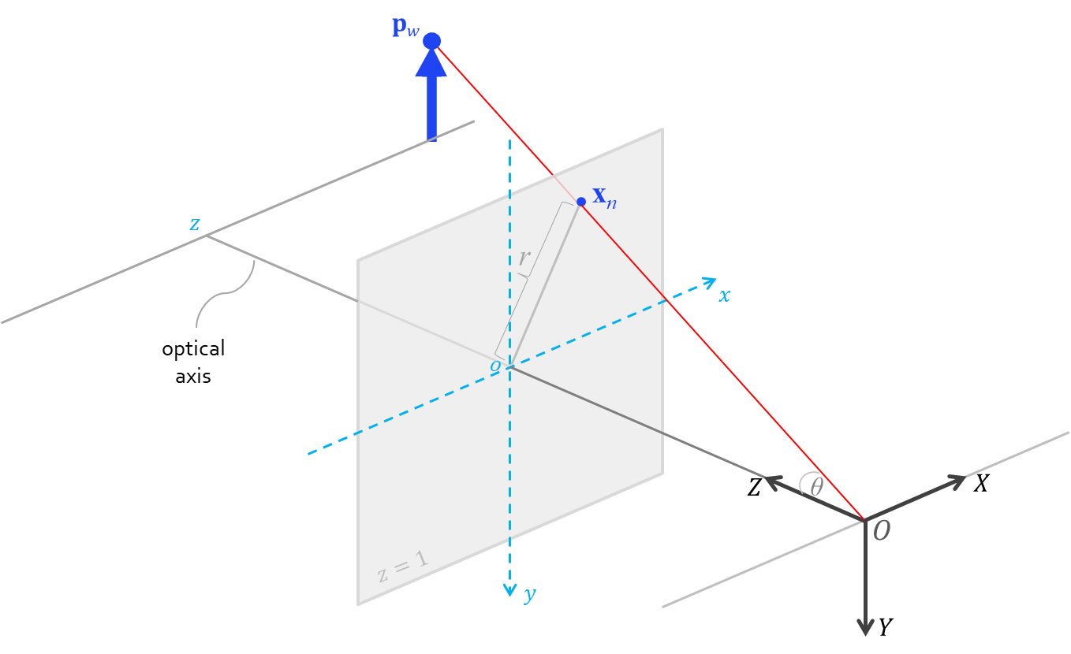
Modeling for Imaging Pipeline
To model the behavior of lens, we need to consider the distortion
Both the two types of distortions are modeled on the normalized retinal plane
If the FOV is extremely large (larger than 100 degrees), i.g. the camera is a fisheye camera, we need to use another model to characterize lens distortions
To model the fisheye distortion
where
are the distortion coefficients

Slide 25
Modeling for Imaging Pipeline
The complete imaging pipeline is modeled as,
point on the normalized retinal plane
(8)
distorted point on the normalized retinal plane
are the intrinsics of the camera (suppose it is an ordinary camera)
R (three DOFs) and t (three DOFs) are the extrinsics of the camera

Slide 26
Modeling for Imaging Pipeline
The process to get the intrinsics and extrinsics of the camera is called single camera calibration
For most cases of single camera calibration, only the intrinsics are what we really need
To model radial and tangential distortions, we use 5 parameters; Actually, more complicated models can be used, but the modeling pipeline is the same
E.g. the thin prism model, the tilted model used in OpenCV

Slide 27
Outline
What is Camera Calibration?
Modeling for Imaging Pipeline
General Framework for the Camera Calibration Algorithm
Initial Rough Estimation of Calibration Parameters
Nonlinear Least-squares
Image Un-distortion

Slide 28
General Framework for the Camera Calibration Algorithm
(Eq. 8, the imaging pipeline)
General idea
If we have a set of known points in the WCS and their images , using Eq. 8, we could have 2n equations
If the number of valid constraints (equations) are enough, Eq. 8 could be solved
All the calibration algorithms follow the above general rules and among them, Zhengyou Zhang’s idea^{[1]} is the most widely used
[1] Z. Zhang, A flexible new technique for camera calibration, IEEE Trans. Pattern Analysis and Machine Intelligence, 2000

Slide 29

General Framework for the Camera Calibration Algorithm
Zhengyou Zhang’s calibration approach
A calibration board with a chessboard pattern is needed
Several images of the board need to be captured
Detect the feature points (cross points) in the images
Based on the correspondence pairs (pixel coordinate and world coordinate of a feature point), equation systems can be obtained
By solving the equation systems, parameters can be determined
Aug. 1, 1965~, now is the director of Tencent AI Lab

Slide 30
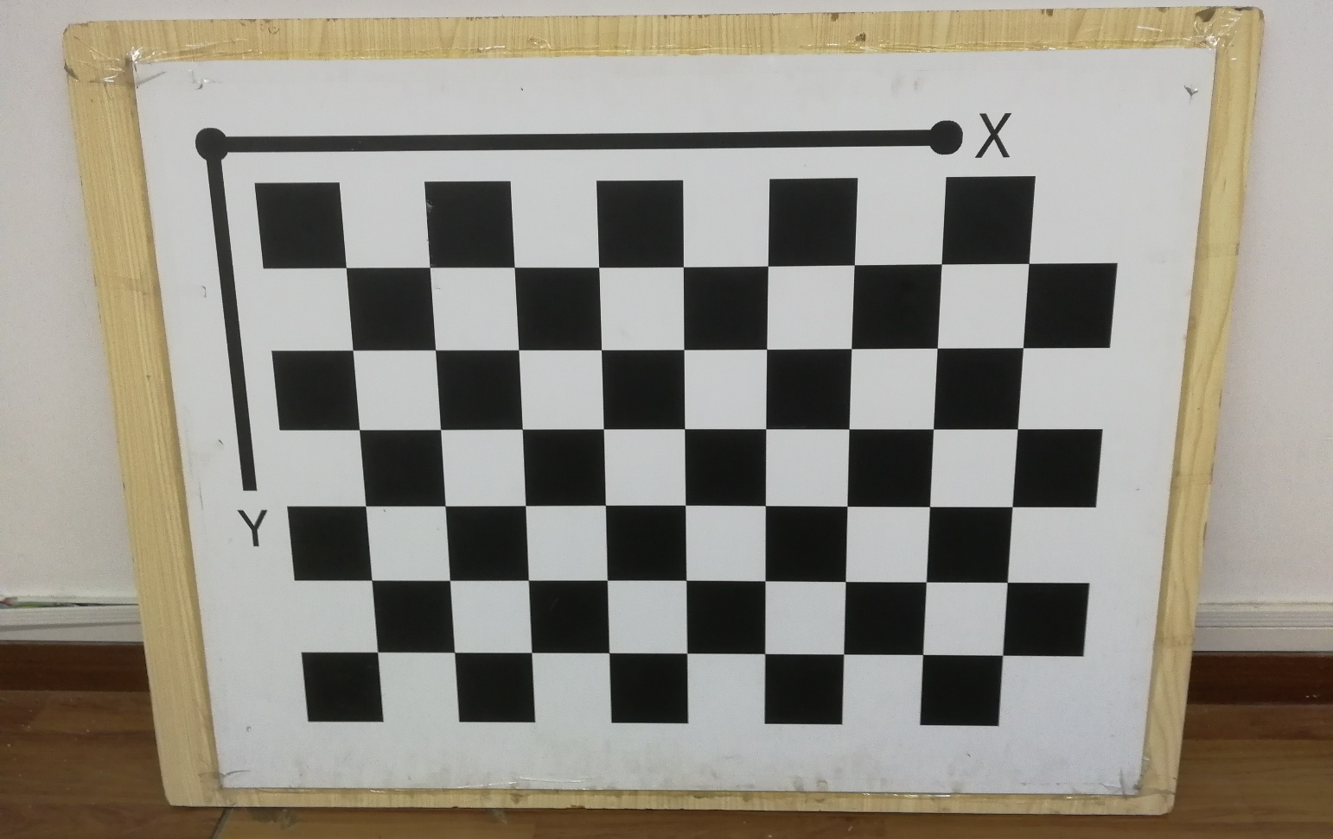
General Framework for the Camera Calibration Algorithm
Zhengyou Zhang’s calibration approach
Calibration board
The number of blocks of one side should be even and the number of blocks of the other side should be odd

Slide 31
General Framework for the Camera Calibration Algorithm
Zhengyou Zhang’s calibration approach

Slide 32
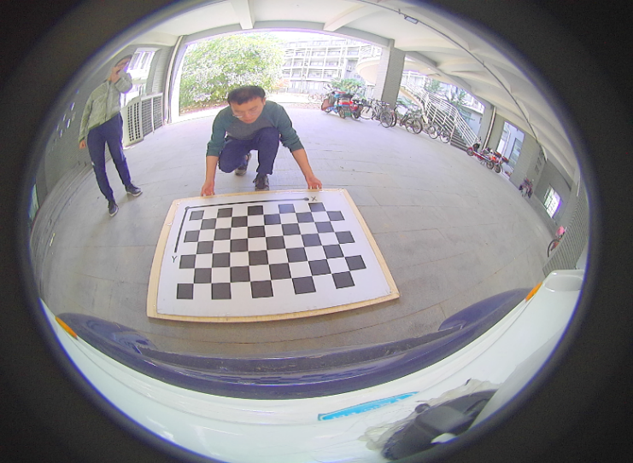
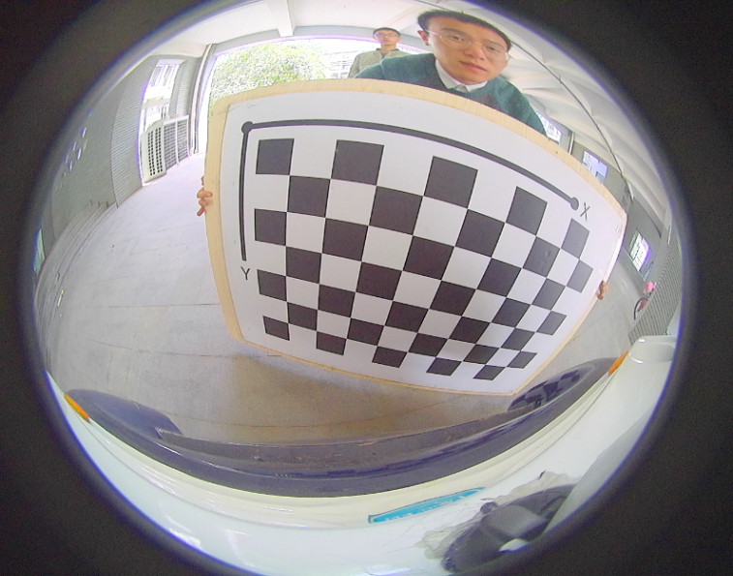
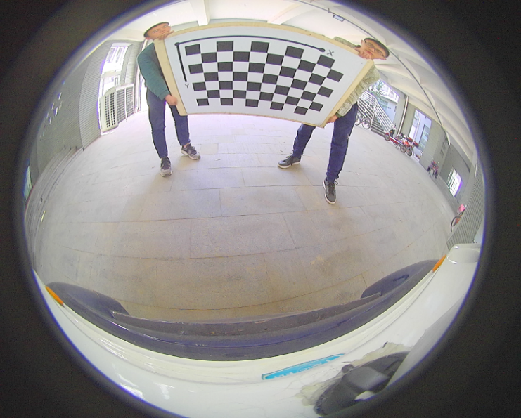
General Framework for the Camera Calibration Algorithm
Zhengyou Zhang’s calibration approach
A set of Calibration board images (20~30)

Slide 33
General Framework for the Camera Calibration Algorithm
Suppose we have M board images and for each image we have N cross points, then the calibration amounts to the following optimization problem,
(9)
where denotes the parameters that needs to be optimized
is the WCS coordinates (determined by the physical calibration board) of the jth cross-point, and is its projection (pixel coordinate) on ith image
denotes the intrinsics matrix

Slide 34
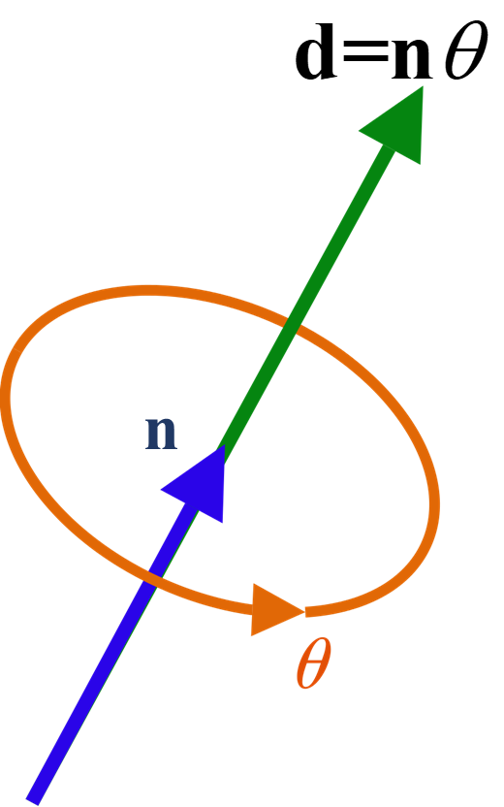
General Framework for the Camera Calibration Algorithm
About the rotation
In 3D Euclidean space, a rotation has 3 DOFs (three Euler angles)
If we use a 3*3 matrix to denote the rotation, we must add extra constraints (the matrix should be orthonormal and its determinant should be 1) and that will make the optimization complicated
Thus, in all modern implementations, a rotation is finally represented by axis-angle
n is a unit 3D vector describing an axis of rotation according to the right hand rule; θ is the rotation angle
d=nθ, a 3D vector denoting the rotation is called axis-angle

Slide 35
General Framework for the Camera Calibration Algorithm
About the rotation
Axis-angle can be uniquely converted to a rotation matrix and vice versa via Rodrigues formula
From axis-angle d=nθ to rotation matrix R
From rotation matrix R to axis-angle d=nθ
(10)
where I is the identity matrix and
i.e., n is the eigenvector of R associated with the eigenvalue 1

Slide 36
General Framework for the Camera Calibration Algorithm
Suppose we have M board images and for each image we have N cross points, then the calibration amounts to the following optimization problem,
(9)
where and the parameters that need to be optimized are,
(d_{i} is the axis-angle representation of R_{i})
Altogether, we have equations (error terms) and unknown parameters
Eq. 9 is a nonlinear optimization problem and does not have a closed-form solution.
It can be solved by iterative methods. But before that, we need to have a good starting point, i.g. we need to have a rough estimate to

Slide 37
Outline
What is Camera Calibration?
Modeling for Imaging Pipeline
General Framework for the Camera Calibration Algorithm
Initial Rough Estimation of Calibration Parameters
Nonlinear Least-squares
Image Un-distortion

Slide 38




Initial Rough Estimation of Calibration Parameters
The task at this step
Given us a set of M images of planar calibration board, estimate the intrinsics (except the ones related to distortion) of the camera and the extrinsics of the camera poses when taking each image

Slide 39
Initial Rough Estimation of Calibration Parameters
The task at this step
Given us a set of M images of planar calibration board, estimate the intrinsics (except the ones related to distortion) of the camera and the extrinsics of the camera poses when taking each image
Distortion coefficients can be safely initialized as zeros
Thus, in initial estimation of other parameters, we use the imaging model without considering distortions,
(Eq. 5)
Given a calibration board, P is a cross-point on it, thus P has the form

Slide 40
Initial Rough Estimation of Calibration Parameters
Result 1: In the camera coordinate system, the direction of the ray pointing from the optical center O to the pixel u (in homogeneous form) on the imaging plane is
The imaging model is
(Eq. 5, u is normalized homogeneous)
imaging
plane
Since should on the ray
‘s direction is
Actually, any can represent the direction of d
u actually does not need to be normalized homogeneous

Slide 41
Initial Rough Estimation of Calibration Parameters
Result 2: In the camera coordinate system, the angle between two rays, pointing from O to x₁ and x₂ (x₁ and x₂ are the homogeneous coordinates of two pixels on the imaging plane), respectively, is determined as,
x₁
x₂
imaging
plane

Slide 42
Initial Rough Estimation of Calibration Parameters
Vanishing points
A feature of perspective projection is that the image of an object that stretches off to infinity can have finite extent. E.g., an infinite scene line is imaged as a line terminating in a vanishing point
Parallel world lines, such as railway lines, are imaged as converging lines and their image intersection is the vanishing point for the direction of the railway
Vanishing point: the vanishing point of a world line l is obtained by intersecting the image plane with a ray parallel to l and passing through the camera center
Another definition: the vanishing point of a world line l is the image of l’s infinity point on the imaging plane

Slide 43
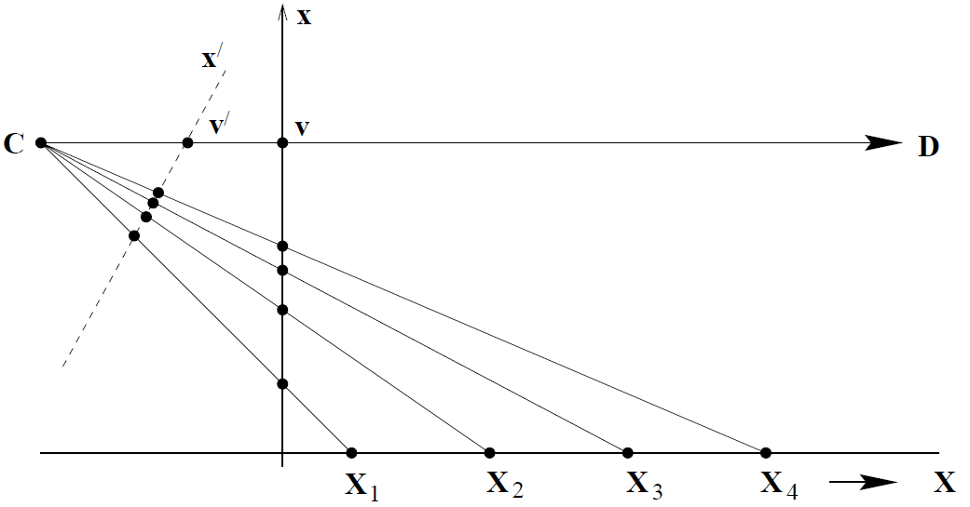
Initial Rough Estimation of Calibration Parameters
Vanishing points: illustrations
The points X_{i}, i = 1, . . . , 4 are equally spaced on the world line, but their spacing on the image line monotonically decreases. In the limit X → ∞, the world point is imaged at x = v on the vertical image line, and at on the inclined image line. Thus the vanishing point of the world line is obtained by intersecting the image plane with a ray parallel to the world line through the camera centre O.

Slide 44
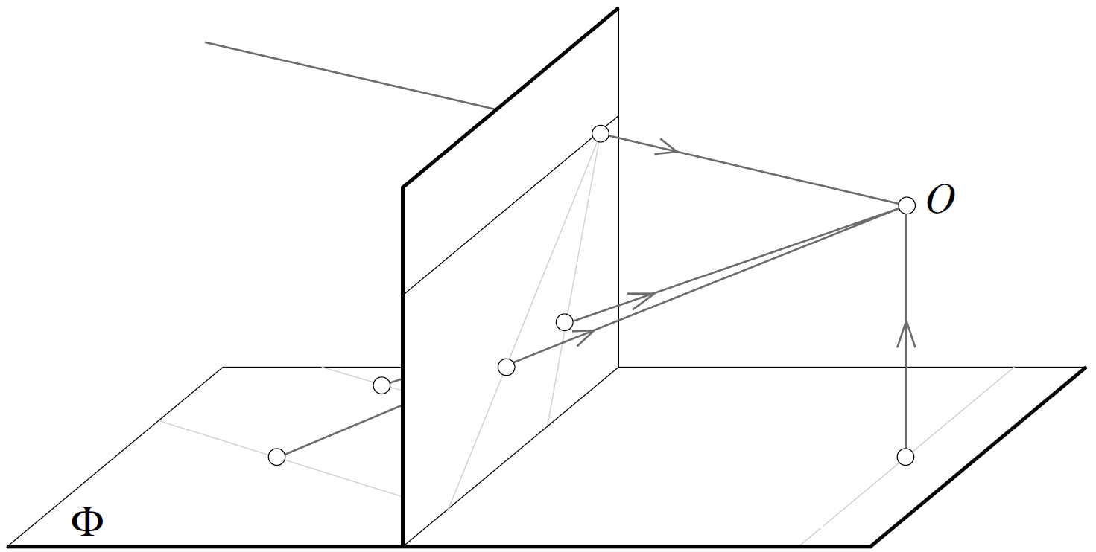
Initial Rough Estimation of Calibration Parameters
Vanishing points: illustrations
Two parallel world lines should have the same infinity point; For each line, its vanishing point is the image of its infinity point; so the images of two parallel world lines would converge to the same vanishing point

Slide 45
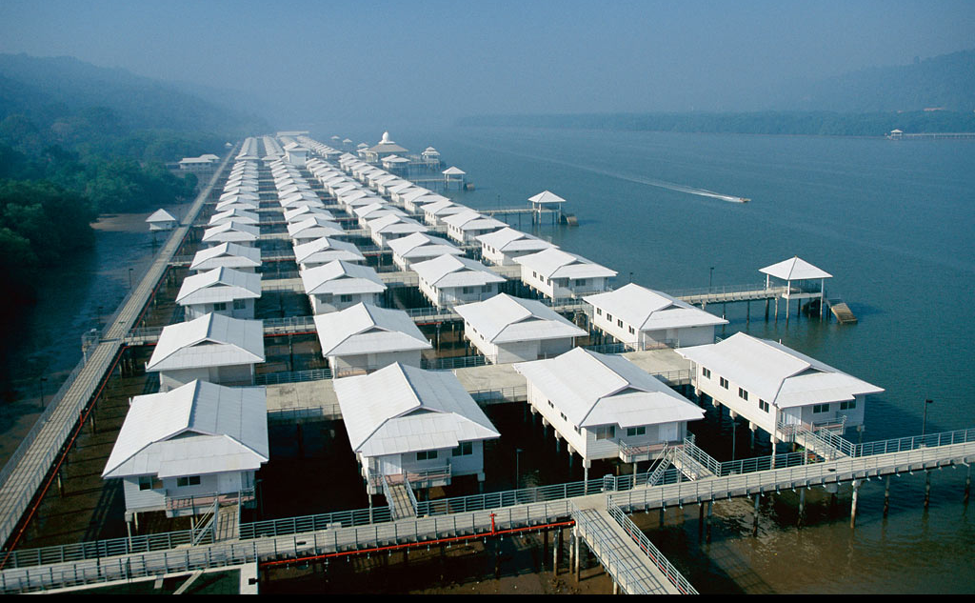
Initial Rough Estimation of Calibration Parameters

Slide 46
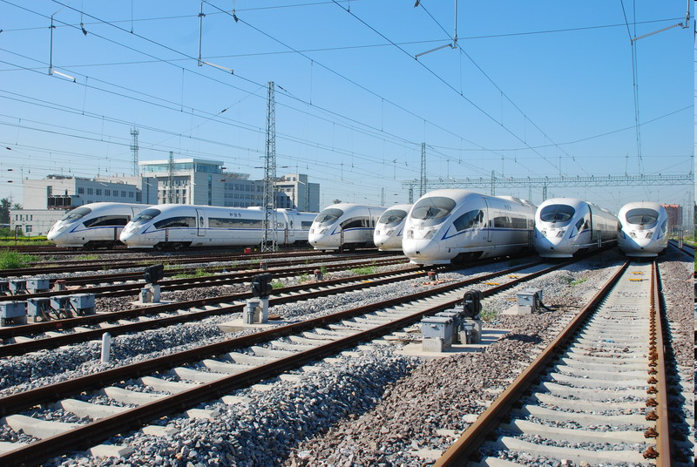
Initial Rough Estimation of Calibration Parameters
JingHu High-speed railway: rails will “meet” at the vanishing point

Slide 47
Initial Rough Estimation of Calibration Parameters
Properties of vanishing points
The vanishing point is on the imaging plane (indicating that it is expressed in pixels)
The vanishing point of the world line l depends only on its direction
A set of parallel world lines have a common vanishing point on the imaging plane
The ray Ov (O is the optical center) is parallel to the world lines who share the same vanishing point v
Result 3: l₁ and l₂ are two world lines on the same plane and v₁ and v₂ are their vanishing points on the imaging plane, respectively. O is the optical center. Let
Then, or
(Using Result 2)

Slide 48
Initial Rough Estimation of Calibration Parameters
Result 4: l₁ and l₂ are two world lines on the same plane perpendicular to each other, and v₁ and v₂ are their vanishing points on the imaging plane, respectively. We have,
(Using Result 3)
Note: This is a key result based on which camera calibration schemes roughly estimate camera’s intrinsics

Slide 49
Initial Rough Estimation of Calibration Parameters
On the projective plane defined by the calibration boards, consider the four lines,
l₁: X-axis, its infinity point is P₁= (1,0,0)^{T}
l₂: Y-axis, its infinity point is P₂= (0,1,0) ^{T}
l₃: line(s) with the infinity point
l₄: line(s) with the infinity point
It can be verified: ,

Slide 50
Initial Rough Estimation of Calibration Parameters
The plane of the calibration board and its image is linked via a homography
Images of P₁, P₂, P₃, P₄ are,
point on the image
homogeneous planar point on the calibration board
H can be estimated in advance for each calibration board image using the techniques introduced in Lect. 3
Denote H by,

Slide 51
Initial Rough Estimation of Calibration Parameters
Based on Result 4, we have
(11)
is symmetric
If we have M calibration board images, we can finally have 2M such equations and then we can solve the elements in K.

Slide 52
Initial Rough Estimation of Calibration Parameters
OpenCV’s implementation adopts a simplified strategy
It does not estimate c_{x} and c_{y} at this step; instead, they are simply taken as the width/2 and height/2 of the image
(11)
(12)

Slide 53
Initial Rough Estimation of Calibration Parameters
OpenCV’s implementation adopts a simplified strategy
(12) becomes
If we have M calibration board images, we can finally have 2M such equations,
We can solve using the least squares technique, and at last f_{x} and f_{y} are obtained

Slide 54
Initial Rough Estimation of Calibration Parameters
Initial estimation of extrinsics
We know that the plane of the calibration board and its image on the normalized retinal plane is linked via a homography
On the other hand, based on the imaging model,
and map (X_{j}, Y_{j}, 1)^{T} to the same point on the normalized retinal plane
and actually represent the same homography

Slide 55
Initial Rough Estimation of Calibration Parameters
Initial estimation of extrinsics
Since
Note: In OpenCV, is estimated as
Since
Then, r₁, r₂, r₃, and t are all initialized
Finally, R=[r₁ r₂ r₃] is converted to its axis-angle representation
Note: Initial estimation of extrinsics needs to be performed to every calibration board image

Slide 56
Outline
What is Camera Calibration?
Modeling for Imaging Pipeline
General Framework for the Camera Calibration Algorithm
Initial Rough Estimation of Calibration Parameters
Nonlinear Least-squares
Image Un-distortion

Slide 57
Nonlinear Least-squares
For nonlinear least-square solutions, please refer to Chapter 9
The camera calibration problem is to solve,
p_{ij}
(9)
err_term_{ij}
In all modern implementations, Eq. 9 is solved by L-M method whose updating step is
our case
,

Slide 58
Nonlinear Least-squares
The core problem is to determine ,
i.e, to determine
Note that:
For derivation simplicity, in the following, we denote
Denote d’s rotation matrix representation by and its vector form by

Slide 59
Nonlinear Least-squares
Denote the 3D point corresponding to p_{ij} in the WCS (determined by the physical calibration board) by P=[X,Y,Z]^{T}
Denote P’s position w.r.t the camera coordinate system by P_{C}=[X_{C},Y_{C},Z_{C}]^{T}
Denote P’s ideal projection on the normalized retinal plane by p_{n}=[x_{n}, y_{n}]^{T}
Denote P’s distorted projection on the normalized retinal plane by p_{d}=[x_{d}, y_{d}]^{T}
Let’s derive the above-mentioned derivatives one by one……

Slide 60
Nonlinear Least-squares
According to Eq. 6 (from the projection on the normalized retinal plane to the final pixel position), we have
We also have a byproduct which will be used later,

Slide 61
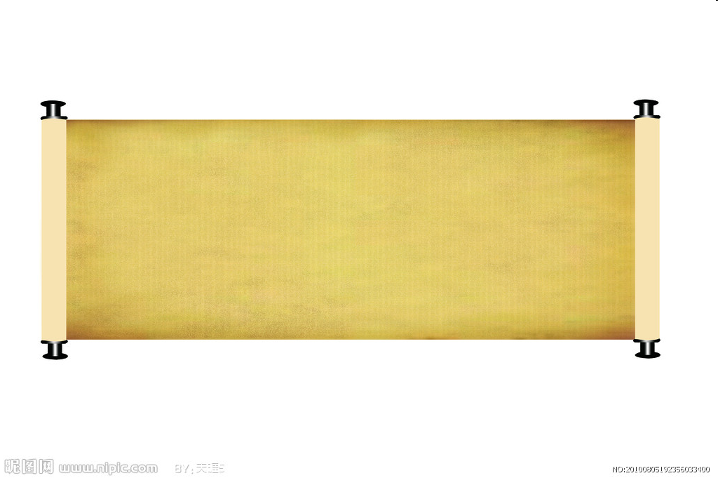

Nonlinear Least-squares
According to Eq. 7 and the notation we have
Then we have,
Also based on Eq. 7, we can have
Its concrete form is a little complicated, but not difficult
Assignment!

Slide 62
Nonlinear Least-squares
According to Eq. 3, we have
According to Eq. 1, we have

Slide 63
Nonlinear Least-squares
According to Rodrigues formula (Eq. 10), we can derive the form of
Assignment!
Then, we can compute,

Slide 64
Outline
What is Camera Calibration?
Modeling for Imaging Pipeline
General Framework for the Camera Calibration Algorithm
Initial Rough Estimation of Calibration Parameters
Nonlinear Least-squares
Image Un-distortion

Slide 65
Image Un-distortion
With the calibrated camera, many amazing applications can be continuously performed….
One naive example, the distorted image can be undistorted
One point on the undistorted image
The corresponding point on the original image with distortion

Slide 66
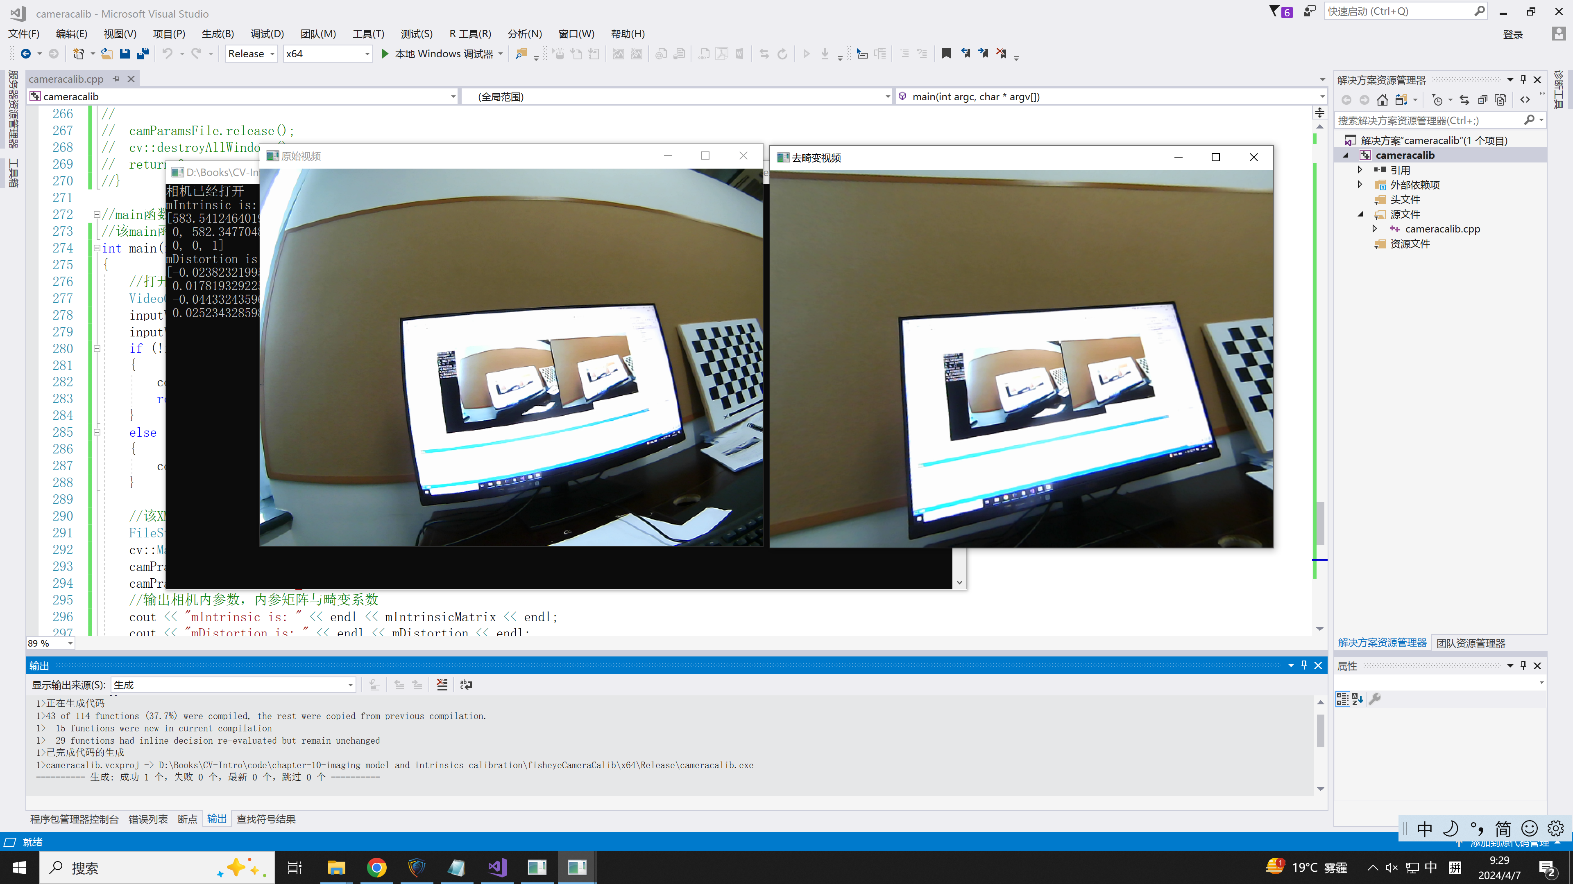
Image Un-distortion

Slide 67
Outline
What is Camera Calibration?
Modeling for Imaging Pipeline
General Framework for the Camera Calibration Algorithm
Initial Rough Estimation of Calibration Parameters
Nonlinear Least-squares
Image Un-distortion

Slide 68
Bird’s-eye-view Generation
Our task is to measure the geometric properties of objects on a plane (e.g., conveyor belt)
Such a problem can be solved if we have its bird’s-eye-view image; bird’s-eye-view is easy for object detection and measurement

Slide 69
Bird’s-eye-view Generation
Three coordinate systems are required
Bird’s-eye-view image coordinate system
World coordinate system
Undistorted image coordinate system
Original fisheye image
Bird’s-eye-view image CS
World CS
Undistorted image CS
Fisheye image
A similarity matrix
A homography matrix
undistortion
a look-up table

Slide 70
Bird’s-eye-view Generation
Basic idea for bird’s-eye-view generation
Suppose that the transformation matrix from bird’s-eye-view to WCS is , the transformation matrix from WCS to the undistorted image is , and the camera intrinsics are known
Then, given a position on bird’s-eye-view, we can get its corresponding position in the original fisheye image as
Then, the intensity of the pixel can be determined using some interpolation technique based on the neighborhood around on the fisheye image

Slide 71
Bird’s-eye-view Generation
Basic idea for bird’s-eye-view generation
Suppose that the transformation matrix from bird’s-eye-view to WCS is , the transformation matrix from WCS to the undistorted image is , and the camera intrinsics are known
The key problem is how to obtain and ?

Slide 72
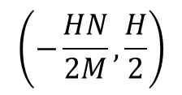
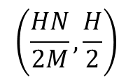
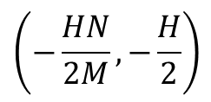
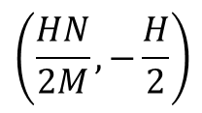
Bird’s-eye-view Generation
Determine
N (pixels)
Y
X
H
(mm)
X
M (pixels)
Y
Note: It is valid only when you think the origin of the world CS is at the center of the bird’s-eye-view image

Slide 73
Bird’s-eye-view Generation
Determine
For a point on bird’s-eye-view, the corresponding point on the world coordinate system is,
Please verify!!

Slide 74
Bird’s-eye-view Generation
Determine
The physical plane (in WCS) and the undistorted image plane can be linked via a homography matrix
If we know a set of correspondence pairs ,
can be estimated using the least-square method

Slide 75
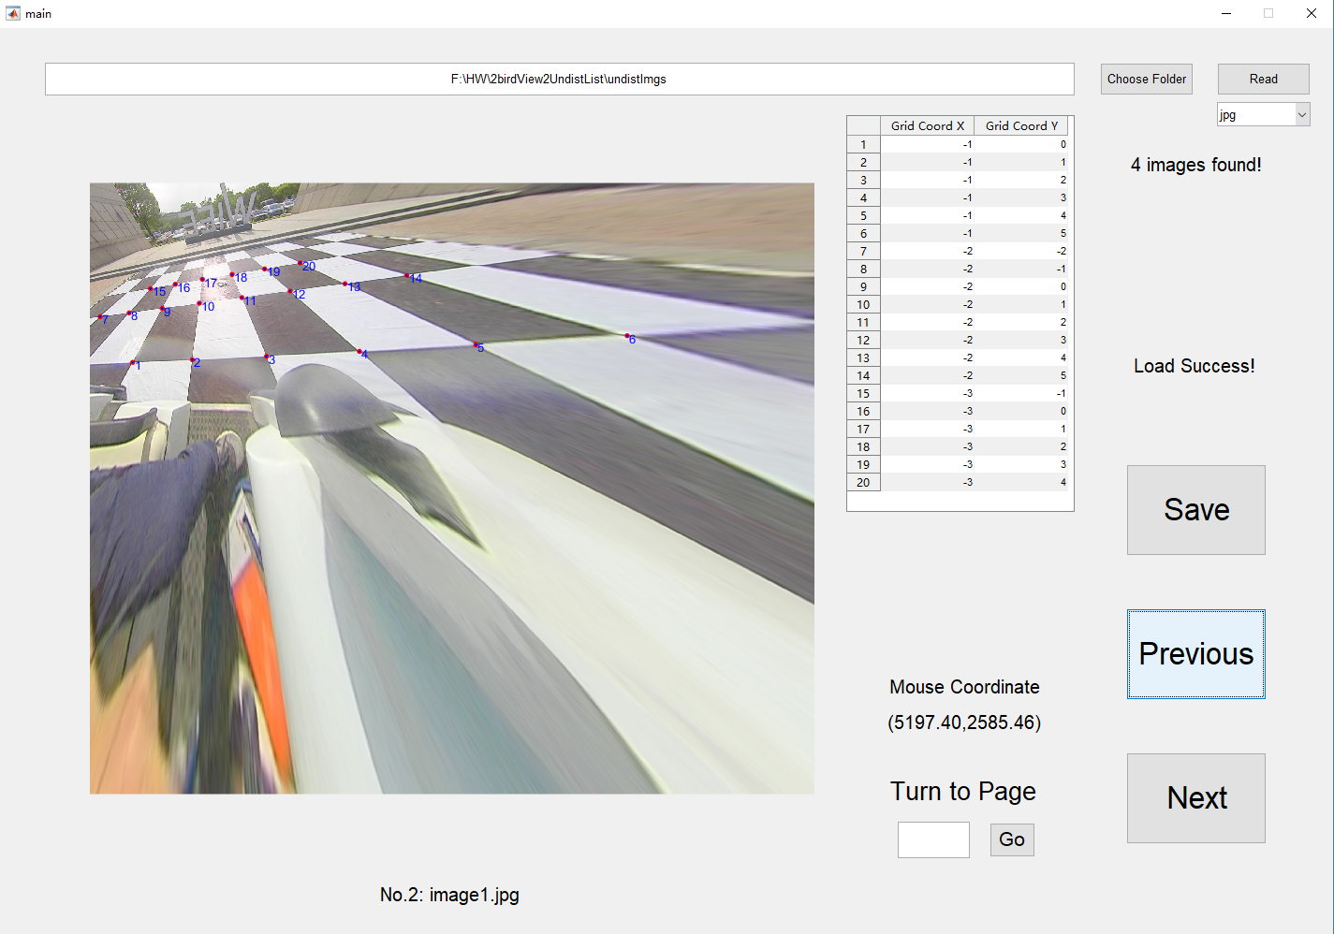
Bird’s-eye-view Generation
Determine
A set of point correspondence pairs; for each pair, we know its coordinate on the undistorted image plane and its coordinate in the WCS

Slide 76
Bird’s-eye-view Generation
When and are known, the bird’s-eye-view can be generated via,

Slide 77
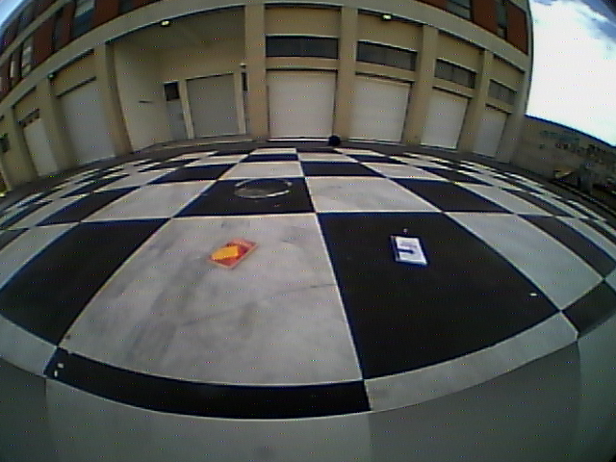
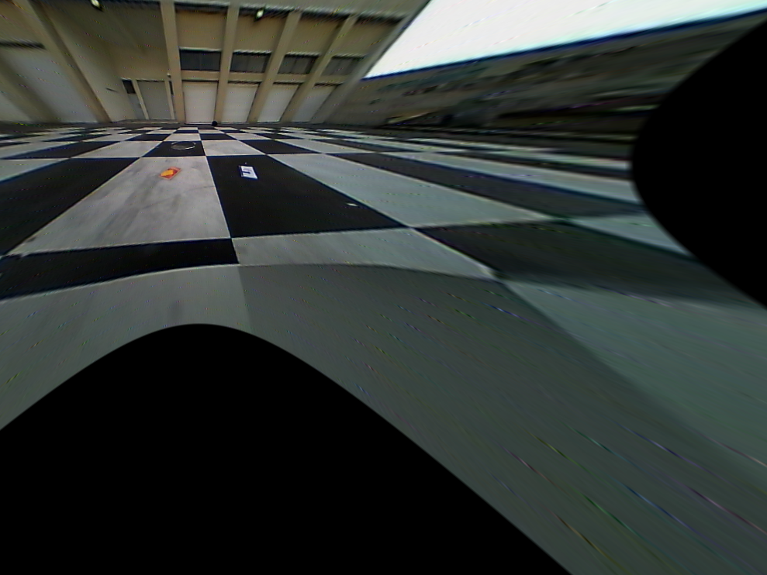
Bird-view Generation
Another example
Original fish-eye image
Undistorted image

Slide 78
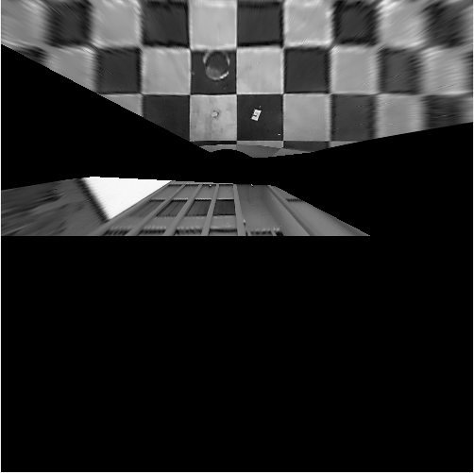
Bird-view Generation
Another example
Original fish-eye image
Bird’s-eye-view

Slide 79

Notes:
79

